Slide 1
COMP 930 Practical #1
Fall 2021 – Week 8
Bryan Elliott

Slide 2
Data Source
Download the PlacementStudents.zip file from Blackboard
Extract the zip, which contains an Excel spreadsheet and a folder with images, somewhere in your OneDrive for Business
You will use the Excel spreadsheet as the data source via the OneDrive for Business connector for this application

Slide 3
Background
You have been recently hired by a company that participates heavily in St. Lawrence College’s Placement Program
The company, which sell reinsurance, takes on students from multiple program to work in its various business units and corporate functions
Because they take on so many students, they have asked you to develop an application to keep track of which students are working with which departments (as well as when they will be onsite)

Slide 4
Student Placement App
Functional Requirements
List the students currently on placement with the company
View the details of a particular student
Edit the details of a particular student
Add a new placement student
Delete a placement student

Slide 5
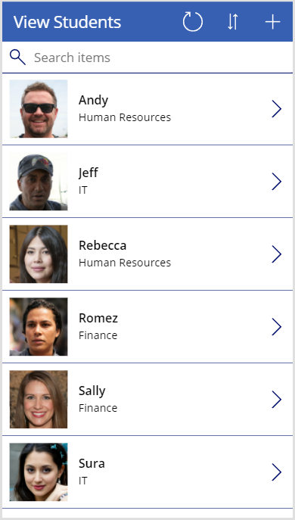
View Screen
The app should have a view screen that satisfies requirement #1
For each student, the screen should show their photo, First Name, and Department
User should be able to view the full details for a student by clicking the right arrow icon in their record
Users should be able to filter the list by using the search field to look for a particular first name
Users should be able to sort the results in ascending or descending order by clicking the ordering icon
Users should be able to refresh the list by clicking the refresh icon
Users should be able to add a new student by clicking the plus icon

Slide 6
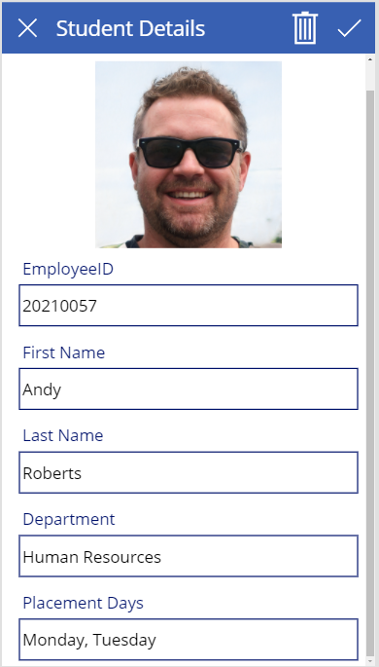
Details Screen
The app should have a details screen which satisfies requirements #2 - #5
The screen should display the student’s picture, Employee ID, First Name, Last Name, Department, and Placement Days
Clicking the X icon should reset the form and navigate back to the view screen
Clicking the check icon should submit the form and navigate back to the view screen
Clicking the trash icon should remove the student from the data source and navigate back to the view screen
When invoked by the plus icon on the view screen, the details screen should present a new form for data entry which is completed by clicking the check icon

Slide 7
Submitting
When complete, export your application from the Power Apps portal
Upload the export file to the Blackboard Practical #1 assignment submission
Practical #1 will be worth 10 points, each given for successfully implementing the detailed functionality for each screen

